Slide 1
Overview:The Adobe PDF Extract API is a cloud-based API that allows developers to extract data from PDF files, including text, images, and tables. It is part of the Adobe Document Services suite of APIs, which also includes the Adobe PDF Embed API and the Adobe PDF Tools API. The PDF Extract API is designed to be used by developers to automate the extraction of data from PDFs, reducing the need for manual data entry. It supports a variety of file formats, including native PDFs and scanned PDFs, and can extract data from tables, forms, and other structured content. The API uses machine learning algorithms to identify and extract data from PDF files, and can be customized to meet the specific needs of your application. It also includes features for converting PDFs to other formats, such as Microsoft Word and Excel. To use the Adobe PDF Extract API, you will need to sign up for an Adobe Developer account and obtain an API key. You can then integrate the API into your application using the provided SDKs and APIs. Pricing for the API is based on usage, with a free trial available for new users.
Overview and Reference
Reference:
https://developer.adobe.com/document-services/docs/overview/pdf-extract-api/
https://developer.adobe.com/document-services/docs/overview/pdf-extract-api/quickstarts/python/
https://github.com/adobe/pdfservices-python-sdk-samples

Slide 2
Demo
Installation
Generation of json file
Image and tables stored in separate folders.
Single integrated file which explains the flow.
Data can be easily derived from json file.
Json file template.
Derive the required data from json file and write to word document.
Compare the files

Slide 3
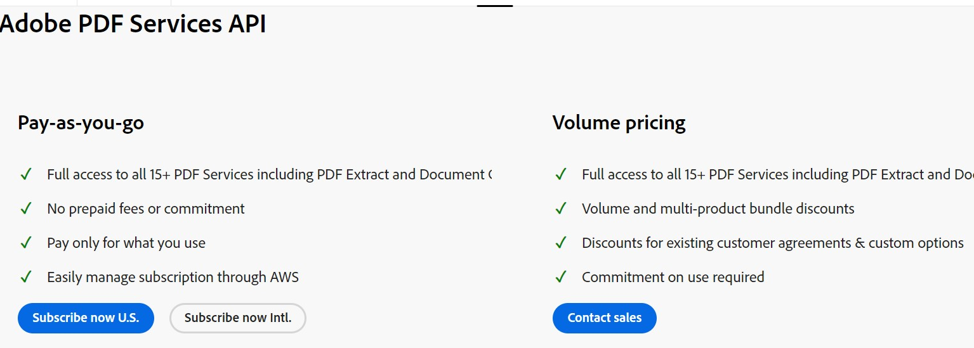
Pricing
Purchase the Adobe PDF Services API for low-volume pay-as-you-go needs, billed monthly on a per-transaction basis at $0.05 per transaction (plus applicable taxes/VAT/GST).
Pricing Details:
https://aws.amazon.com/marketplace/pp/prodview-wzykfz2grnbdk

Slide 4
Limitations
File size: Files up to a maximum of 100MB are supported.
Number of Pages: Non-scanned PDFs have a limit of 400 pages. Scanned PDFs have a limit of 150 pages or less. Limits may be lower for files with multiple tables. For larger files or those with complex layouts, it is recommended to split the file into smaller sections before processing.
Rate limits: Keep request rate below 25 requests per minutes.
Page Size: The API supports standard page sizes not to exceed 17.5” or less than 6” in either dimension.
Hidden Objects: PDF files that contain content that is not visible on the page like javascript, OCG (optional content groups), etc are not supported. Files that contain such hidden information may fail to process. For such cases, [removing hidden content](https://helpx.adobe.com/acrobat/using/removing-sensitive-content-pdfs.html) prior to processing files again may return a successful result.
Language: The API is currently optimized for English language content. Files containing content in other Latin languages should return good results, but may have issues with non-English punctuation.
OCR and Scan quality: The quality of text extracted from scanned files is dependent on the clarity of content in the input file. Conditions like skewed pages, shadowing, obscured or overlapping fonts, and page resolution less than 200 DPI can all result in lower quality text output.
Form fields: Files containing XFA and other fillable form elements are not supported.
Unprotected files: The API supports files that are unprotected or where security restrictions allow copying of content. Files that are secured and do not allow copying of content will not be processed.
Annotations: Content in PDF files containing annotations such as highlights and sticky notes will be processed, but annotations that obscure text could impact output quality. Text within annotations will not be included in the output.
PDF Producers: The Extract API is designed to extract content from files that contain text, table data, and figures. Files created from applications that produce other types of content like illustrations, CAD drawings or other types of vector art may not return quality results.

